Slide 2
THE DISCIPLES RELATIONSHIP:
TO HIMSELF
An Athlete
A Soldier
TO HIS LORD
The Potter and the Clay
The Vine and the Branches
A Child of God
TO HIS BRETHREN
A Member of the Body
“My Brother’s Keeper”
A Servant
TO THE WORLD
Strangers & Pilgrims
Salt & Light
An Apologist
Fishers of Men

Slide 3
LESSON 6: A Child of God The Disciple’s Security
“But as many as received Him, to them He gave the right to become children of God, even to those who believe in His name, who were born, not of blood nor of the will of the flesh nor of the will of man, but of God.” (John 1:12-13)

Slide 4
The Disciple as a Child of God
How does a child become part of a family?
Born into it
Adoption (Gk. huiothesia)
“Blessed be the God and Father of our Lord Jesus Christ, who has blessed us with every spiritual blessing in the heavenly places in Christ, just as He chose us in Him before the foundation of the world, that we would be holy and blameless before Him. In love He predestined us to adoption as sons through Jesus Christ to Himself, according to the kind intention of His will” (Eph. 1:3-5)
(Rom 8:15, 23; 9:4; Gal. 4:4-7)

Slide 5
The Disciple as a Child of God
As a child of God, there are Blessings and Responsibilities.
We have a new name
We are Object of God’s Love and Attention
A Father’s Provision
A Father’s Protection
A Father’s Guidance
An Inheritance
We must live up to our precious new name
We must return God’s love
We must walk by faith and trust God
We must grow and mature

Slide 6
Blessings of Being a Child of God
We have a new name
We are Object of God’s Love and Attention
A Father’s Provision
A Father’s Protection
A Father’s Guidance
An Inheritance
“…and when he (Barnabas) had found him (Paul), he brought him to Antioch. And for an entire year they met with the church and taught considerable numbers; and the disciples were first called Christians in Antioch.” (Acts 11:25-26)
1John 3:7-10; Phil. 2:14-16

Slide 7
Blessings of Being a Child of God
We have a new name
We are Object of God’s Love and Attention
A Father’s Provision
A Father’s Protection
A Father’s Guidance
An Inheritance
“For God so loved the world, that He gave His only begotten Son, that whoever believes in Him shall not perish, but have eternal life.” (John 3:16)
“See how great a love the Father has bestowed on us, that we would be called children of God; and such we are. For this reason the world does not know us, because it did not know Him.” (1John 3:1)
Ps 34:15-18; 1 Pet 3:8-12; Rev 21:4

Slide 8
Blessings of Being a Child of God
We have a new name
We are Object of God’s Love and Attention
A Father’s Provision
A Father’s Protection
A Father’s Guidance
An Inheritance
“I have been young and now I am old, yet I have not seen the righteous forsaken or his descendants begging bread.” (Psa. 37:25)
“For the Gentiles eagerly seek all these things; for your heavenly Father knows that you need all these things. But seek first His kingdom and His righteousness, and all these things will be added to you.” (Matt. 6:32-33)
1Tim. 5:8; Matt. 7:7-11; Jam. 1:5, 17; Phil. 4:19

Slide 9
Blessings of Being a Child of God
We have a new name
We are Object of God’s Love and Attention
A Father’s Provision
A Father’s Protection
A Father’s Guidance
An Inheritance
“But the Lord is faithful, and He will strengthen and protect you from the evil one.” (2Thes. 3:3)
“No temptation has overtaken you but such as is common to man; and God is faithful, who will not allow you to be tempted beyond what you are able, but with the temptation will provide the way of escape also, so that you will be able to endure it.” (1Cor. 10:13)
Heb. 13:5-6; 1John 4:4; 5:4; Rom. 8:31-39; John 10:27-30

Slide 10
Blessings of Being a Child of God
We have a new name
We are Object of God’s Love and Attention
A Father’s Provision
A Father’s Protection
A Father’s Guidance
An Inheritance
Deut. 6:4-9
“These words, which I am commanding you today, shall be on your heart. You shall teach them diligently to your sons and shall talk of them when you sit in your house and when you walk by the way and when you lie down and when you rise up.” (vss. 6-7)
“Children, be obedient to your parents in all things, for this is well-pleasing to the Lord. Fathers, do not exasperate your children, so that they will not lose heart.” (Col. 3:20-21 -> ref. Eph. 6:4)

Slide 11
Blessings of Being a Child of God
We have a new name
We are Object of God’s Love and Attention
A Father’s Provision
A Father’s Protection
A Father’s Guidance
An Inheritance
“For all who are being led by the Spirit of God, these are sons of God.” (Rom. 8:14)
Psa. 23 – The Lord is my shepherd…
He leads, restores, guides…
Your rod & staff comfort me…
My cup overflows…
Heb. 12:4-11
“It is for discipline that you endure; God deals with you as with sons; for what son is there whom his father does not discipline?” (vs. 7)

Slide 12
Blessings of Being a Child of God
We have a new name
We are Object of God’s Love and Attention
A Father’s Provision
A Father’s Protection
A Father’s Guidance
An Inheritance
“…but you have received a spirit of adoption as sons by which we cry out, “Abba! Father!” The Spirit Himself testifies with our spirit that we are children of God, and if children, heirs also, heirs of God and fellow heirs with Christ, if indeed we suffer with Him so that we may also be glorified with Him.” (Rom. 8:15-17)
Col. 1:9-12
“…giving thanks to the Father, who has qualified us to share in the inheritance of the saints in Light.” (vs. 12)
Rev. 21:7; 1Pet. 1:3-5

Slide 13
Responsibilities of Being a Child of God
We must live up to our precious new name
We must return God’s love
We must walk by faith and trust God
We must grow and mature

Slide 14
Responsibilities of Being a Child of God
We must live up to our precious new name
We must return God’s love
We must walk by faith and trust God
We must grow and mature
“Do not be bound together with unbelievers; for what partnership have righteousness and lawlessness, or what fellowship has light with darkness… “Therefore, come out from their midst and be separate,” says the Lord. “and do not touch what is unclean; and I will welcome you. And I will be a father to you, and you shall be sons and daughters to Me,” says the Lord Almighty.” (2Cor. 6:14-18)
Prov. 13:20; 2Tim. 2:19

Slide 15
Responsibilities of Being a Child of God
We must live up to our precious new name
We must return God’s love
We must walk by faith and trust God
We must grow and mature
“You shall love the Lord your God with all your heart, and with all your soul, and with all your mind. This is the great and foremost commandment.” (Matt. 22:37-38)
1John 5:1-4
“By this we know that we love the children of God, when we love God and observe His commandments. For this is the love of God, that we keep His commandments…” (vss. 2-3)

Slide 16
Responsibilities of Being a Child of God
We must live up to our precious new name
We must return God’s love
We must walk by faith and trust God
We must grow and mature
2Tim. 1:8-12
“…join with me in suffering for the gospel according to the power of God, who has saved us and called us with a holy calling, not according to our works, but according to His own purpose and grace which was granted to us in Christ Jesus from all eternity...For this reason I also suffer these things, but I am not ashamed; for I know whom I have believed and I am convinced that He is able to guard what I have entrusted to Him until that day.” (vss. 8,12)
2Cor. 5:7

Slide 17
Responsibilities of Being a Child of God
We must live up to our precious new name
We must return God’s love
We must walk by faith and trust God
We must grow and mature
“You therefore, beloved, knowing this beforehand, be on your guard so that you are not carried away by the error of unprincipled men and fall from your own steadfastness, but grow in the grace and knowledge of our Lord and Savior Jesus Christ.” (2Pet. 3:17-18)
2Cor. 10:13; Eph. 4:11-15

Slide 18
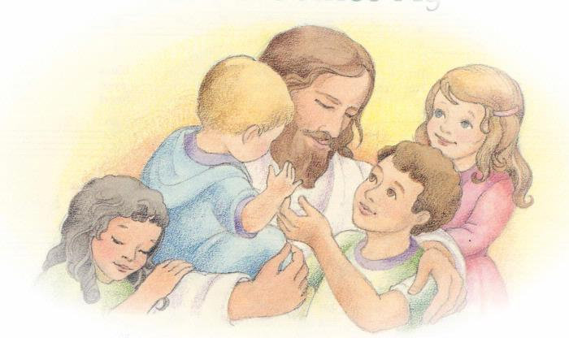
Become Like Children
Matt. 18:1-5
Humility
Trust
Innocence
Forgiveness
Growth

Slide 19
A Child of God
Consider the relationship between a child and a father. Can you describe your relationship with God, our Father, with similar words? Are you doing your part?
What are some results when you show your trust and faith in God, our Father? Who might benefit when these qualities are displayed?
How will you improve your relationship with God, our Father, this week? What will you do to show Him your thankfulness for all He has done for you?

